Slide 1
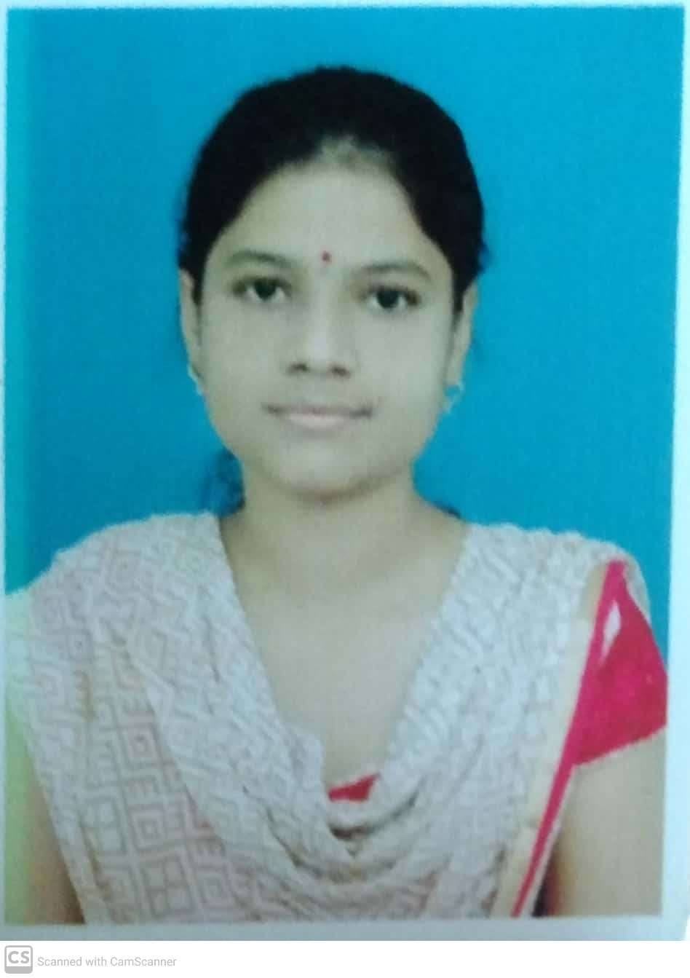
SAJJANAM SRAVANI SOFTWARE ENGINEER
SUMMARY
PROFESSIONAL ACHIEVEMENTS
To obtain a position that will allow me to utilize my technical skills, strengths and willingness to learn in making an organization successful.
Worked on "Reducing Propagation Delay using Hybrid Adders (Carry saver Adder and Carry increment Adder)” in VLSI Domain.
Participated the event named AMPLE-2K19 on the paper entitled "A Low Power Single Input Level Shifter for Oxide Thin Film Transistors" at SVCE, Tirupathi.
TOOLS & TECHNOLOGY:
CAREER ACHIEVEMENTS
Java
MySQL
Maven
Jenkins
GitHub
Eclipse
Visual Studio
Awarded First Prize in the event named TECHNOSANGRAM-2K19 on the paper entitled "Artificial Retina using Thin Film Transistors" in National Level Technical Symposium at AITS, Tirupathi.
Awarded Elite in NPTEL Online Certification on "Problem Solving Through Programming In C" from IIT Kharagpur in 2018.
PERSONAL SKILLS:
Time Management.
Self-Motivated
Flexibility.
Hard Working
RELEVANT WORK EXPERIENCE
Worked on developing application using Spring & Hibernate, Angular, Spring boot & Microservices.
Worked on Eclipse, Web Technologies, MySQL, Apache Tomcat, Visual Studio and Maven.
Hands-on experience in Spring MVC web as the framework developed a web application as a mini project.
EDUCATION:
Completed my Graduation in the stream of Electronics & Communication Engineering at AITS, Tirupathi in the year 2020 with 79.19%.

